Slide 1
PROBLEM SOLVING AND PROGRAMMING USING PYTHON
Mr.Panduraju Pagidimalla
Assistant Professor, Dept of AIML

Slide 2
Unit-I: Software requirements for programming

Slide 3
Editor (IDE), Compiler, Linker, Loader

Slide 4
It is the job of a programmer to write and run the program. This process involves four steps.
  Writing and editing programs
  Compiling the program
  Linking the program with required library modules
  Executing the program

Slide 5
Integrated Development Environment (IDE)
An integrated development environment (IDE) is a software application that helps programmers develop software code efficiently.
It increases developer productivity by combining capabilities such as software editing, building, testing, and packaging in an easy-to-use application.
Just as writers use text editors and accountants use spreadsheets, software developers use IDEs to make their job easier.
The IDE integrates all these things and more into one package so that you can edit, compile, run, and debug your code all in one program.
Some IDEs, such as IntelliJ IDEA, Eclipse, and Lazarus, contain the necessary compiler, interpreter, or both;

Slide 6
Because the CPU understands only machine language instructions, programs that are written in a high-level language must be translated into machine language.
Depending on the language that a program has been written in, the programmer will use either a compiler or an interpreter to make the translation.

Slide 7
Compiler
A compiler is a program that translates a high-level language program into a separate machine language program.
  The machine language program can then be executed at any time it is needed.

Slide 8
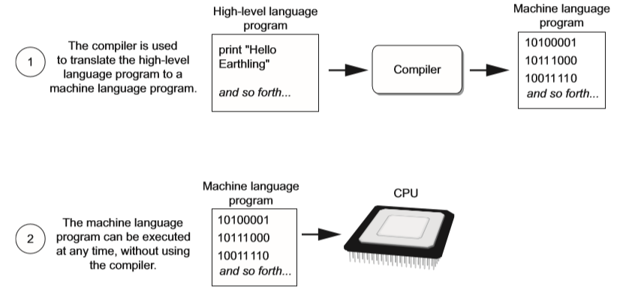
Compiler

Slide 9
Interpreter
An interpreter is a program that both translates and executes the instructions in high-level language program.
As the interpreter reads each individual instruction in the program, it converts it to machine language instructions and then immediately executes them.

Slide 10
Interpreter

Slide 11
Assembler
Assembler is used to translate an assembly language (low-level language) program to machine language

Slide 12
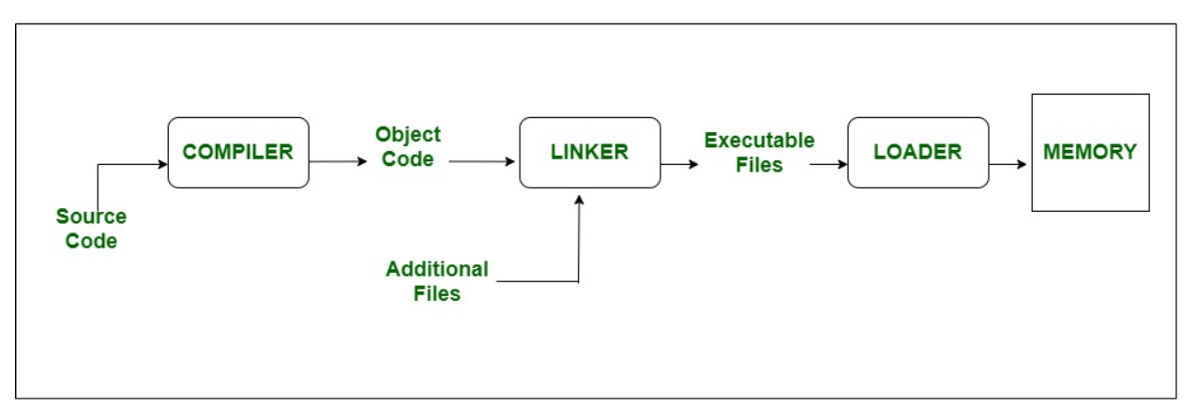
Linker
A linker is a special program that combines the object files, generated by the compiler/assembler and other pieces of code to originate an executable file that has a .exe extension.

Slide 13
Loader
It is special program that takes input of executable files from linker, loads it to main memory, and prepares this code for execution by computer.
Loader allocates memory space to program.

Slide 14
THANK YOU !

